Slide 1
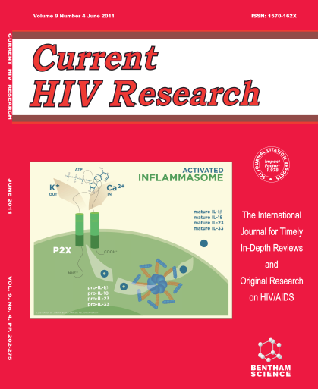
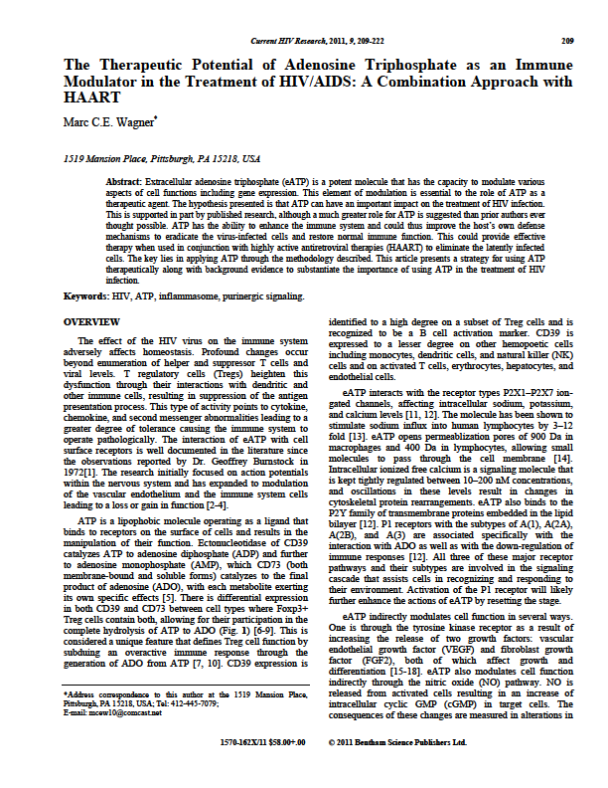
AS A NEW DAY APPROACHES
IT IS TIME TO LOOK AT ATP IN A WHOLE NEW LIGHT
There is no better time than the present to test this hypothesis.
More than 30 years of research has supplied a level of detail and clarity that supports the powerful effects that extracellular ATP exerts on cell function. It has proven to be an agent involved in genetic modulation by altering the expression of many cytokines, chemokines and second messenger molecules. It is known to activate key cellular pathways that aid in the innate immune system response to pathogens. Applying ATP in combination with highly active antiretroviral therapy (HAART) for the treatment of HIV disease could be just the right measure to achieve a state of cure for this disease.

