Slide 1
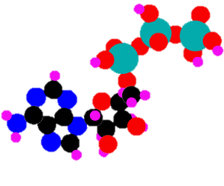
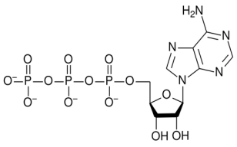
The Clinical Experience With Adenosine Triphosphate
ATP has been administered clinically to patients in the advanced stages of small cell lung cancer. This prior application now helps to facilitate an easier transition into the treatment of the HIV infected individual.

